Slide 1


REAL DREAM
Discover
YOUR DREAM HOME TODAY
UMA THIYAGARAJAN

Slide 2



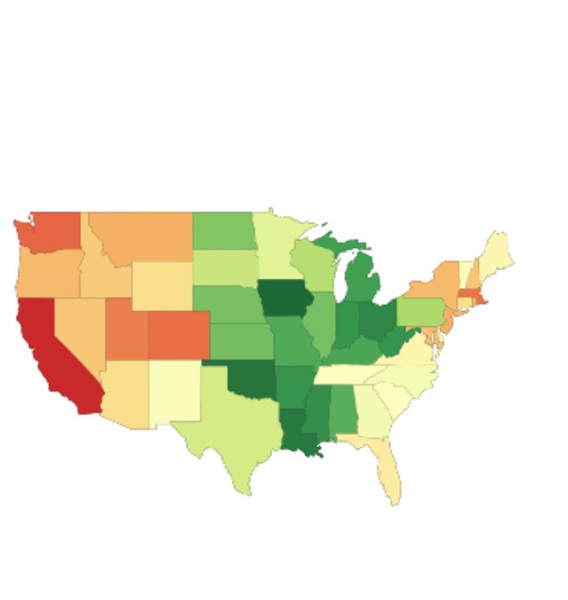
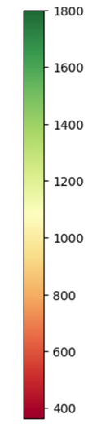


Want to know how big and where to buy a home?
400 sqft
800 sqft
1200sqft
1800 sqft
California
Montana
Iowa
800 sqft
Dakota
November 2024 Median house price - Iowa -$241000
Size of House affordable with Iowa state Median house Price
Area sqft
Recommended House area : 1800 sqft

Slide 3
Factors influencing house purchase
Smaller Pool of Affordable Homes
Increased Mortgage Payments
Larger Down Payments
Impact on First-Time Buyers
Consumer Debt-to-Income Ratios
Reduced Homeownership Rates
Few Terminologies in upcoming slides:
CPI, Consumer Price Index is a measure of how the average price of a basket of goods and services changes over time
Inflation is the rate at which prices for goods and services increase over time
HPI, House Price-to-Income ratio = House Price/ Income
( Recommended 3 - 4)
DTI, Debt-to-Income Ratio=(Total Monthly Debt /Total Gross Monthly Income) x 100
( Recommended 28 % - 31 %)

Slide 4
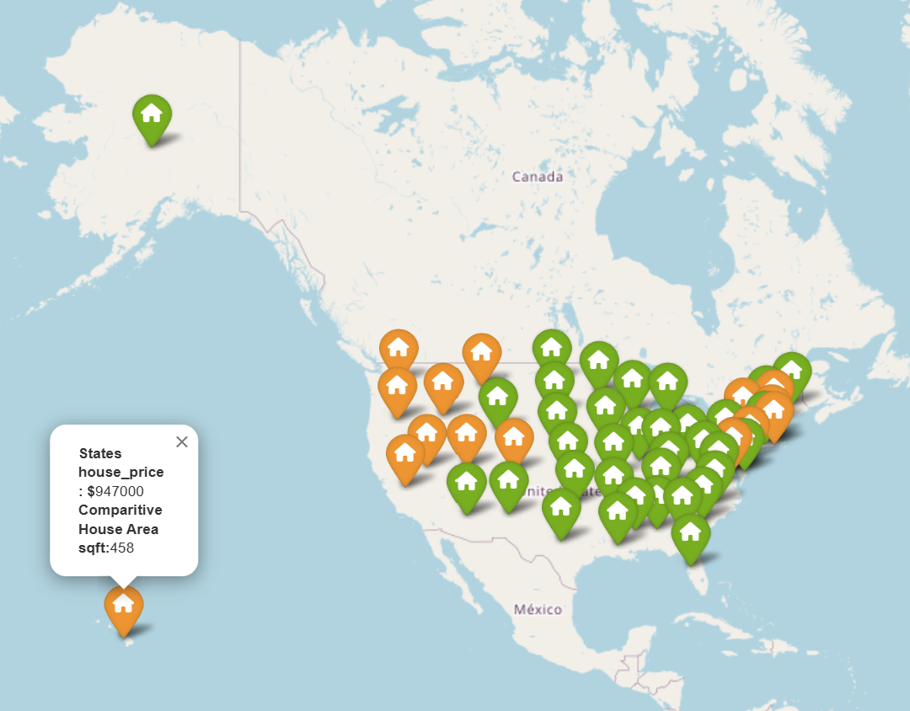
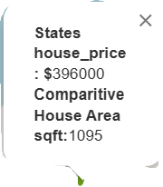
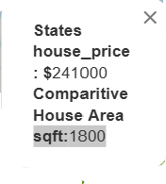
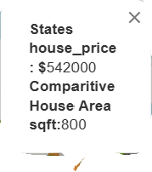
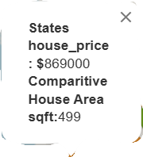
House price vs Size of the house
Interactive map
Fewer Options in Budget
Shift towards Renting

Slide 5
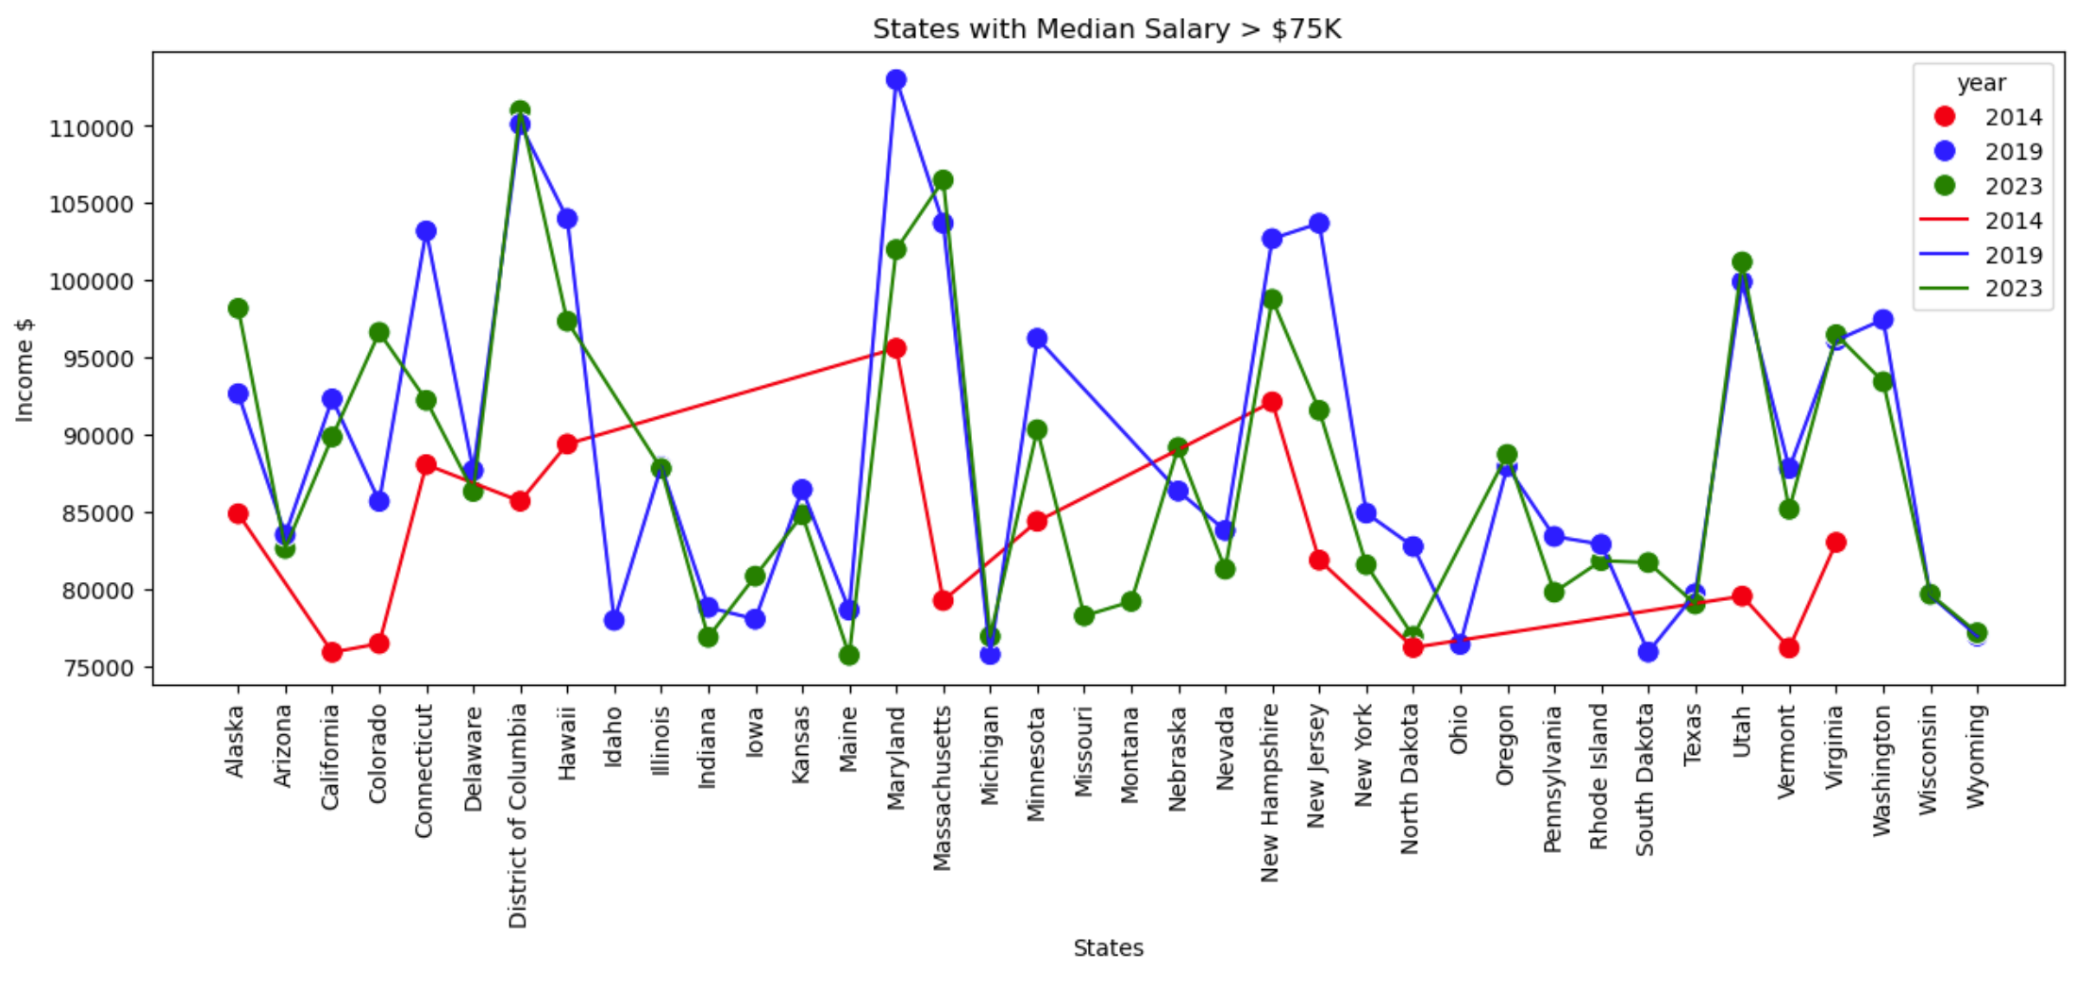
Understanding Nationwide Income
Data Analyst current Median US Salary 75K -80K
Below chart shows states with median salary greater than 75K
States

Slide 6
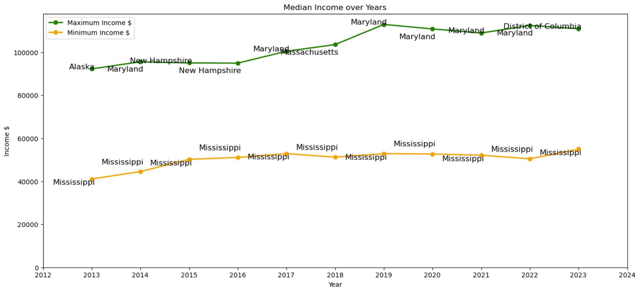
States with high and low Salary over the years

Slide 7
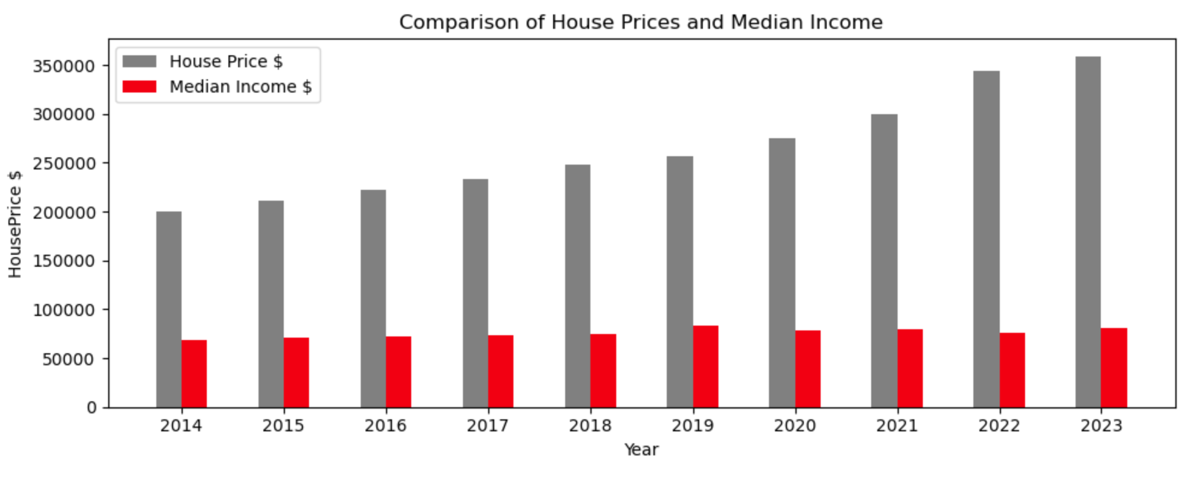
Personal Income
Income
Down Payment savings
Mortgage Payments
3. Planning for size of house

Slide 8
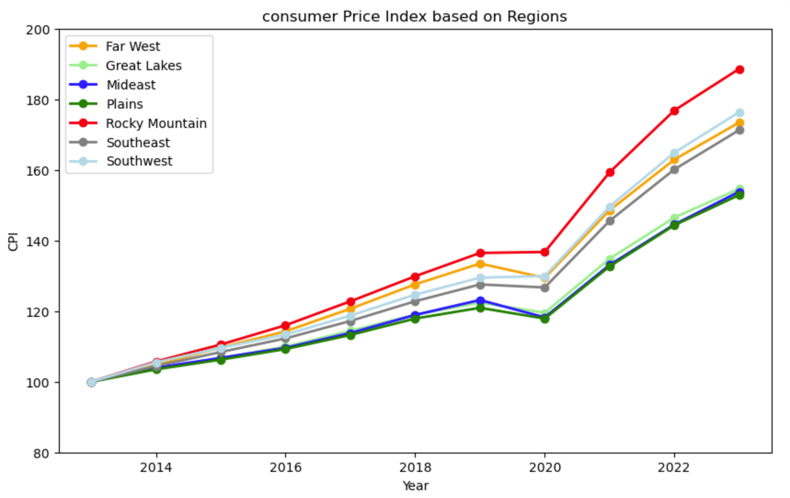
Consumer Price Index
All Regions show steady rise in the CPI since 2020

Slide 9
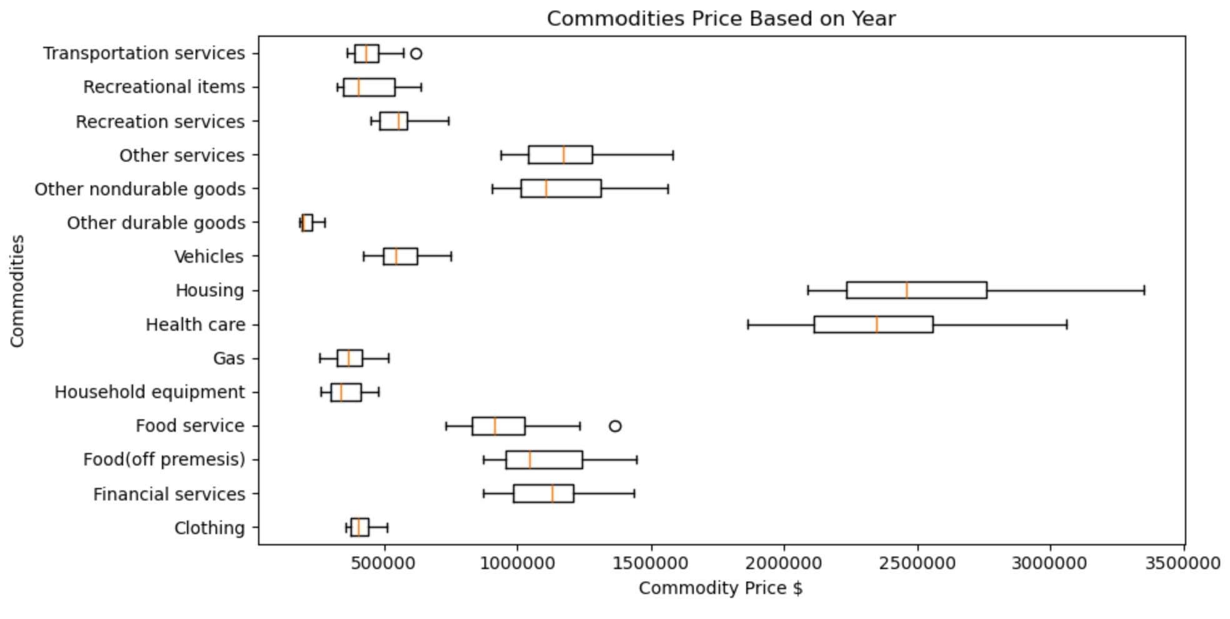
Commodities
Housing and Healthcare are the components showing high values from the median value

Slide 10
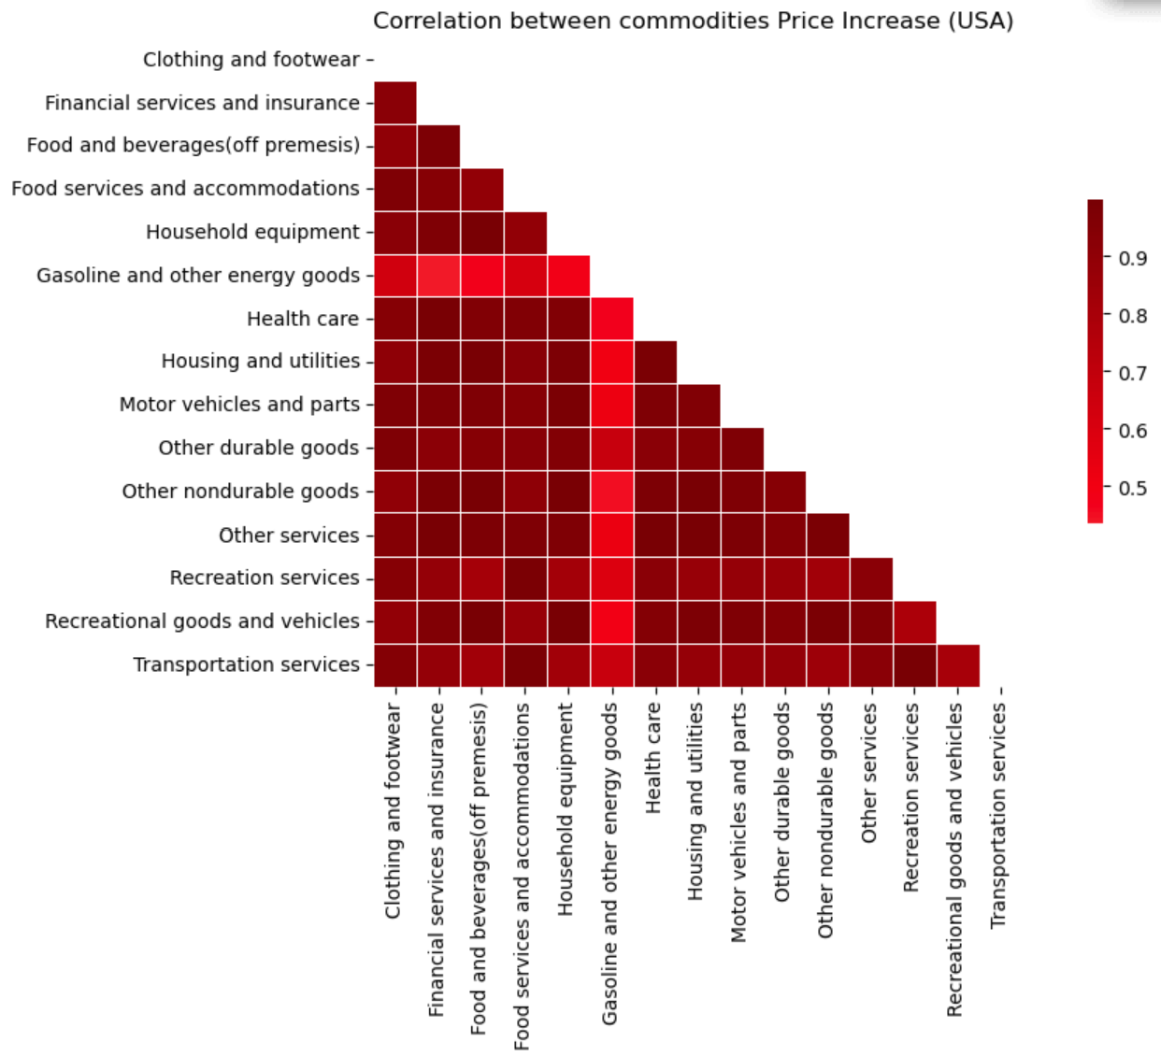
Commodities Price analysis
Each Commodity price has increased
Positive correlation between all commodities

Slide 11
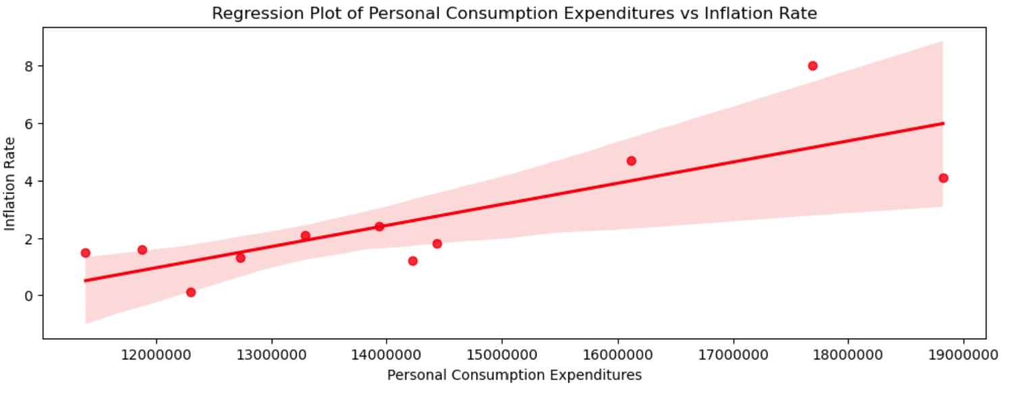
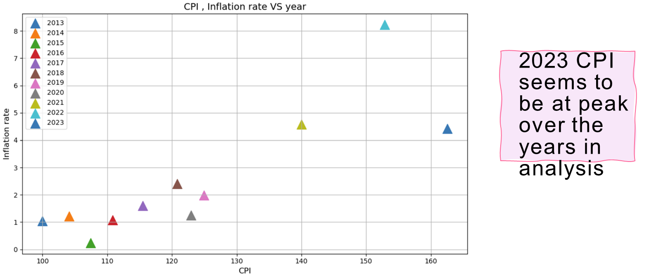
Understanding Inflation
USA
Positive correlation between personal expenditure and inflation rate
$

Slide 12
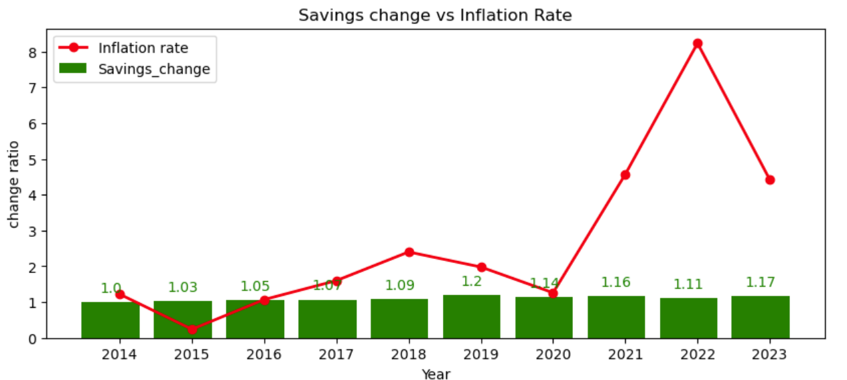
Savings
Based on these analysis, savings towards down payments is a challenge but it is trying to improve

Slide 13
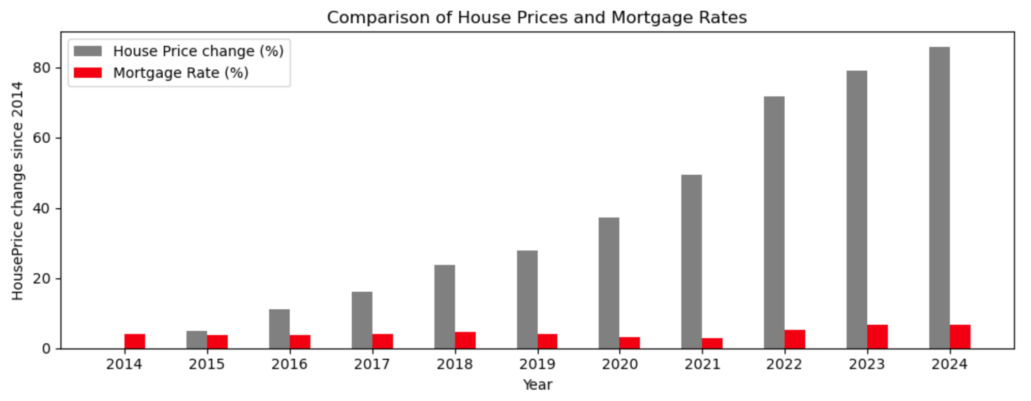
Mortgage Payments Planning
Based on the Increasing house prices the Federal Reserve (Fed) began cutting interest rates
Reduces Mortgage Payments

Slide 14
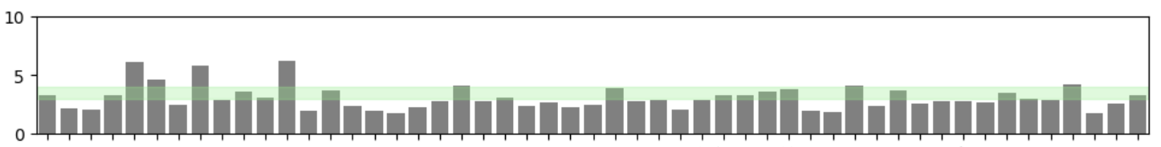
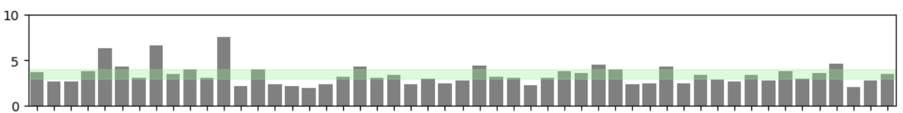
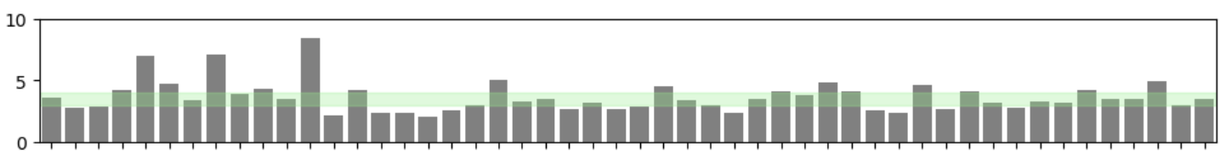
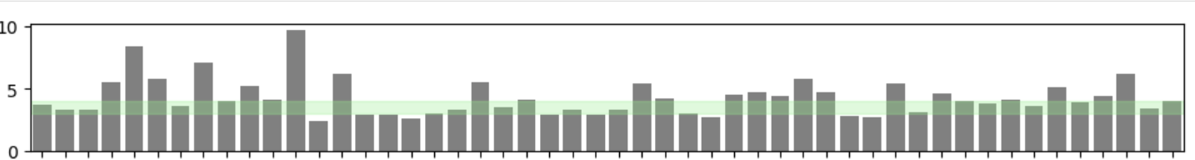
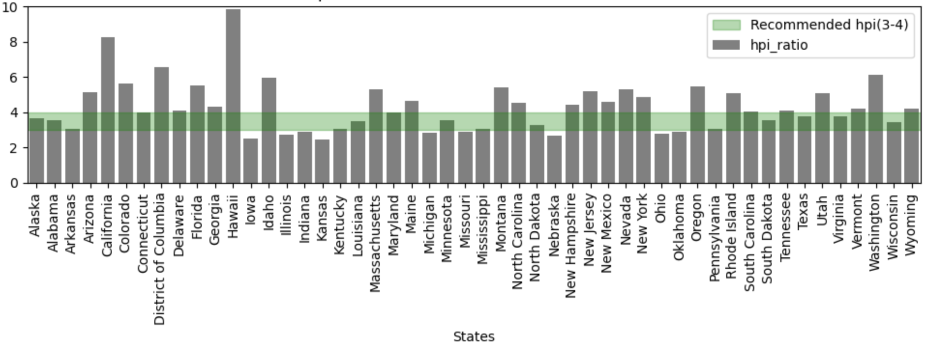
States showing HPI ratio based on median income
2019
2020
2021
2022
2023

Slide 15
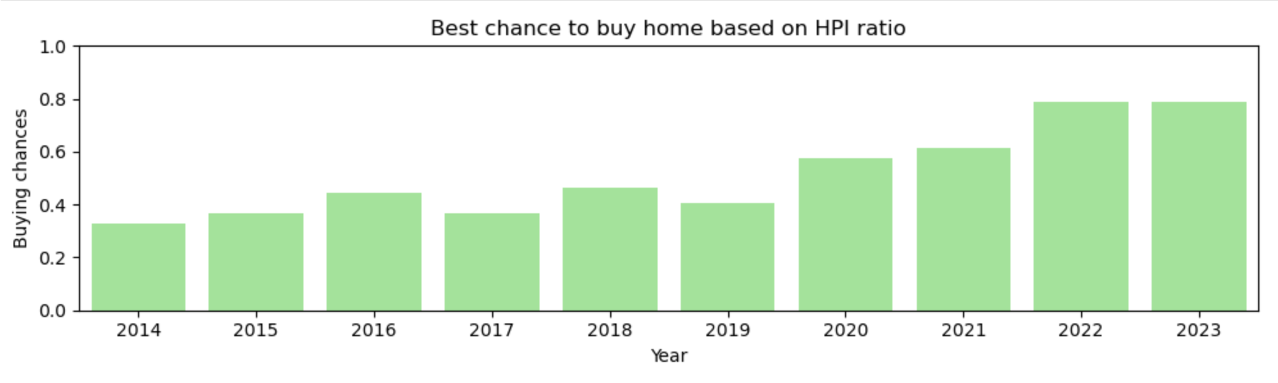
Based on House Price to Income ratio , current US scenario since 2022 seems good to buy homes for most states .

Slide 16
With one’s Income ,
Debit-to-Income
Front-end ratio = 31 % of monthly income
Mortgage payment < Front-end ratio
House-Price to Income ratio
HPI 3-4
Down Payment saved to 20 % of house price
Mortgage rate and Loan Term
Other commitments – college fees, family size expenditure
First Time Buyers- long time to save down payments
-barriers to enter house market
Limited access for low-income groups
Government Assistance needed

